Slide 1
Traffic Network Analytics
GRAPH AND WEB ANALYTICS PROJECT
Web-based traffic network analysis and route optimization using IoT sensor data
Team
M. Mahender Reddy – 2320090065 (Team Lead)
P. Karthik Sai – 2320030456
J. Pavan Kumar Varma – 2320030083
Notes:
Introduce the team and the project: a web-based system that analyses traffic sensor data as a graph and suggests better routes.

Slide 2
Why This Project?
Roads generate huge amounts of sensor data, but raw rows of speed and location do not tell anyone what to do.
The problem
The gap
Our answer
Congestion, breakdowns and accidents waste time and fuel, and put lives at risk. Authorities cannot see patterns in thousands of records.
Normal tables and charts treat each sensor alone. They miss how sensors connect, and which ones matter most to the whole network.
Treat sensors as a graph, analyse it, and share the results in an easy web dashboard that anyone can use.
Graph and Web Analytics · Traffic Network Analytics
2
Notes:
Explain the motivation. Traffic management needs insight, not raw data. Graph analytics shows relationships between sensors, and a web dashboard makes the insight usable by non-technical people.

Slide 3
Objectives and Approach
1
2
3
4
Understand
Locate
Model
Optimise
Study speeds, traffic patterns, incidents and events.
Map sensors and accident hotspots.
Build a graph of nearby sensors.
Compare shortest and traffic-aware routes.
Colab CSV
→
Clean
→
Explore
→
Graph
→
Streamlit app
Tools: Pandas, NumPy, Matplotlib, Seaborn, NetworkX, Folium, Plotly, Streamlit.
Graph and Web Analytics · Traffic Network Analytics
3
Notes:
Four objectives, one per stage. The same code first runs as a Colab analysis, then is packaged as a Streamlit app and exposed through ngrok.

Slide 4
Dataset and Preparation
1,000
9
10
records
columns
traffic sensors
Column | Meaning
timestamp, sensor_id | When and which vehicle sensor reported
vehicle_speed (km/h) | Speed, from 20 to 120
latitude, longitude | Sensor location
traffic_pattern, event_type | Traffic state and event category
incident_report, accident_hotspot | Incident type and 0/1 hotspot flag
Cleaning: timestamps converted to dates, 232 empty incident reports set to “No Report”, duplicates removed, and date, hour and weekday added.
Graph and Web Analytics · Traffic Network Analytics
4
Notes:
The data comes from IoT edge computing for public traffic management. Cleaning keeps all 1,000 records and adds time features for analysis.

Slide 5
How the System Works
Step 3
Step 1
Step 2
Step 4
Step 5
Group by sensor
Upload CSV
→
Prepare data
→
→
Build graph
→
Analyse
Sensor file with 1,000 records loads into the app.
Fix dates, fill empty reports, add hour and weekday.
Average location and speed, main pattern, hotspot flag.
Link each sensor to its 3 nearest, using Haversine km.
Centrality scores, shortest and traffic-aware routes.
Output on the dashboard
Why a pipeline
KPIs, charts, maps, the sensor graph, centrality tables and route comparison.
Any new traffic CSV can be uploaded and analysed again with no code changes.
Graph and Web Analytics · Traffic Network Analytics
5
Notes:
Walk through the five stages from uploading the CSV to analysing the graph. Every stage runs automatically in the Streamlit app, so a new CSV gives new results.

Slide 6
Traffic Analytics Results
1,000
70.39
155
total records
average speed, km/h
accident hotspots
Four traffic patterns
Speed by pattern
Speed spread
Light, Heavy, Clear and Moderate each appear in about a quarter of the records.
Average speed is close for every pattern, roughly 69 to 72 km/h. Pattern alone does not explain speed.
Speeds range from 20 to 120 km/h, with peaks near both ends.
Graph and Web Analytics · Traffic Network Analytics
6
Notes:
These numbers are the KPI cards on the dashboard. A key insight: heavy traffic does not show clearly lower speed in this data, so a single column is not enough. This is why a network view helps.

Slide 7
Incidents and Accident Hotspots
155
Records by incident type
records flagged as accident hotspot
No Report
232
Traffic Jam
206
768
Accident
196
Police Blockade
183
records with an incident report
Breakdown
183
Interactive Folium maps on the dashboard plot every sensor and hotspot.
Graph and Web Analytics · Traffic Network Analytics
7
Notes:
768 equals 1,000 minus the 232 empty reports. Traffic jams and accidents are the most common reported incidents.

Slide 8
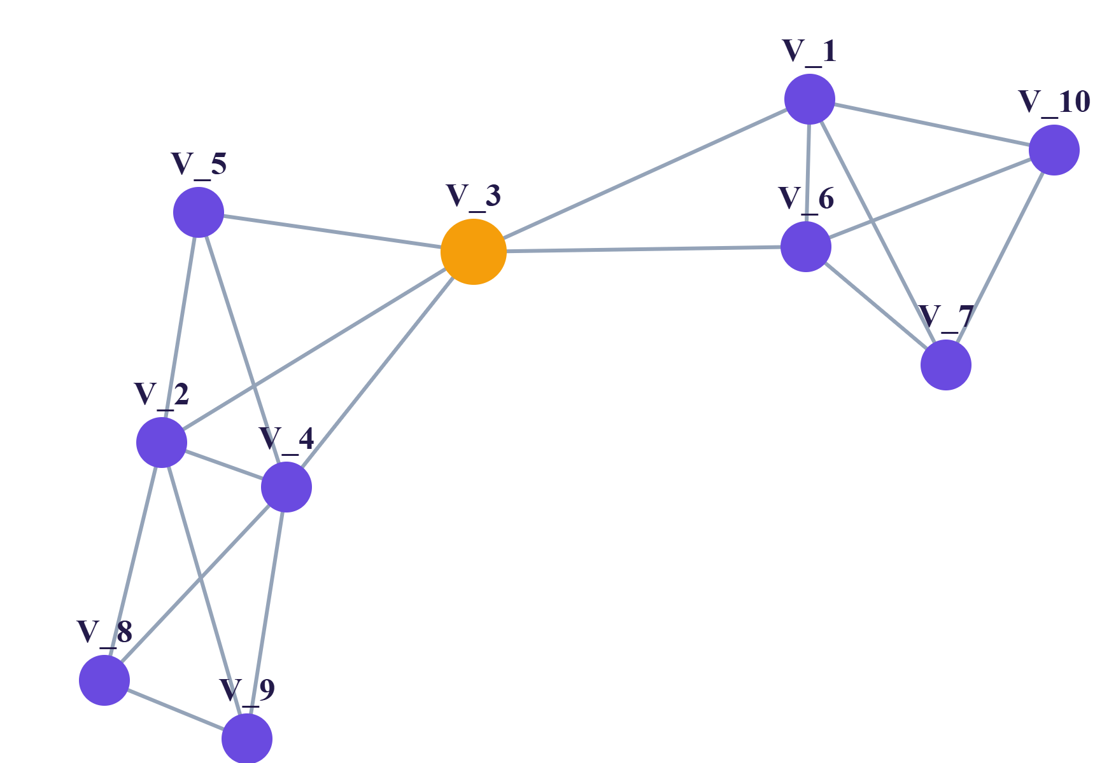
Traffic Sensor Network
10
19
nodes
edges
How it is built
Each sensor is a node at its average location. It links to its 3 nearest sensors, with distance from the Haversine formula.
Reading the graph
19 edges form two clusters. Orange Vehicle_3 is the bridge between them.
Graph and Web Analytics · Traffic Network Analytics
8
Notes:
The graph shows structure that tables hide: two groups of sensors, joined by one central sensor, Vehicle_3.

Slide 9
Centrality Analysis: Key Sensors
Degree and Betweenness
Degree
V_3
0.555
0.555
Vehicles 3, 2 and 4 are the best connected, at 0.555.
V_2
0.555
0.166
V_4
0.555
0.166
V_1
0.444
0.166
V_6
0.444
0.166
Betweenness
V_10
0.333
0.000
Only Vehicle_3 stands out at 0.555. Five sensors score 0.
V_5
0.333
0.000
V_7
0.333
0.000
V_8
0.333
0.000
Meaning
V_9
0.333
0.000
Vehicle_3 is the critical junction. Monitor it first.
Graph and Web Analytics · Traffic Network Analytics
9
Notes:
Degree centrality counts direct links. Betweenness counts how many shortest paths pass through a sensor. Vehicle_3 is the bridge of the network.

Slide 10
The Streamlit Web Dashboard
Total records
Traffic sensors
Average speed
Accident hotspots
1,000
10
70.39 km/h
155
1. Traffic Analytics
2. Interactive Map
3. Sensor Network
4. Centrality
5. Route Optimization
Sensors and accident hotspots.
Degree and betweenness tables.
Patterns, speed and event charts.
Graph of nearby sensors.
Pick source and destination.
Upload a traffic CSV in the sidebar and the whole analysis appears in one scrolling web page.
Graph and Web Analytics · Traffic Network Analytics
10
Notes:
The top row shows the four KPI cards from the live app. Below are the five modules a user scrolls through.

Slide 11
Route Optimization
Shortest route
Traffic factor per sensor
Least total distance in km between the two sensors.
Clear
× 1.0
Traffic-aware route
Moderate
× 1.3
Least total cost, where each link costs distance × the average traffic factor of its two sensors.
× 1.7
Heavy
A heavier sensor makes every link around it costlier.
In the app, choose a source and destination (for example Vehicle_2 to Vehicle_1) and press Find Optimized Routes. Both paths are drawn on the sensor graph so they can be compared.
Graph and Web Analytics · Traffic Network Analytics
11
Notes:
Both routes use NetworkX shortest-path search. The first weights edges by distance; the second weights them by distance times traffic factor, so it can avoid congested sensors.

Slide 12
Conclusion and Future Scope
What we achieved
Benefits
Future scope
A complete pipeline from raw IoT data to graph insight and route advice in a web app.
Faster spotting of risky sensors, hotspots and better route choice for traffic authorities.
Live sensor streams, machine learning to predict hotspots, and real road-network routing.
Thank you
Graph and Web Analytics · Traffic Network Analytics
12
Notes:
Summarise: why the project matters, what was built, and where it can grow.

